Slide 1
Course Intro
Patrick Mathias & Shannon Haymond

Slide 2
Workshop Workflow
Notes:
So now that you've met us let's discuss for a moment how this workshop is going to work

Slide 3
Introduction to Instructors
Patrick Mathias
Department of Laboratory Medicine and Pathology
University of Washington School of Medicine
pcm10@uw.edu
Shannon Haymond
Lurie Children’s Hospital
Northwestern University Feinberg School of Medicine
SHaymond@luriechildrens.org

Slide 4
Course Info
Lectures, live demos of code, and exercises
Emphasizes reproducibility, more advanced use of R, and introductory material for machine learning
Website: https://github.com/pcmathias/MSACL-intermediate-R-course
Website updated as we improve/make additions
Download repository contents

Slide 5
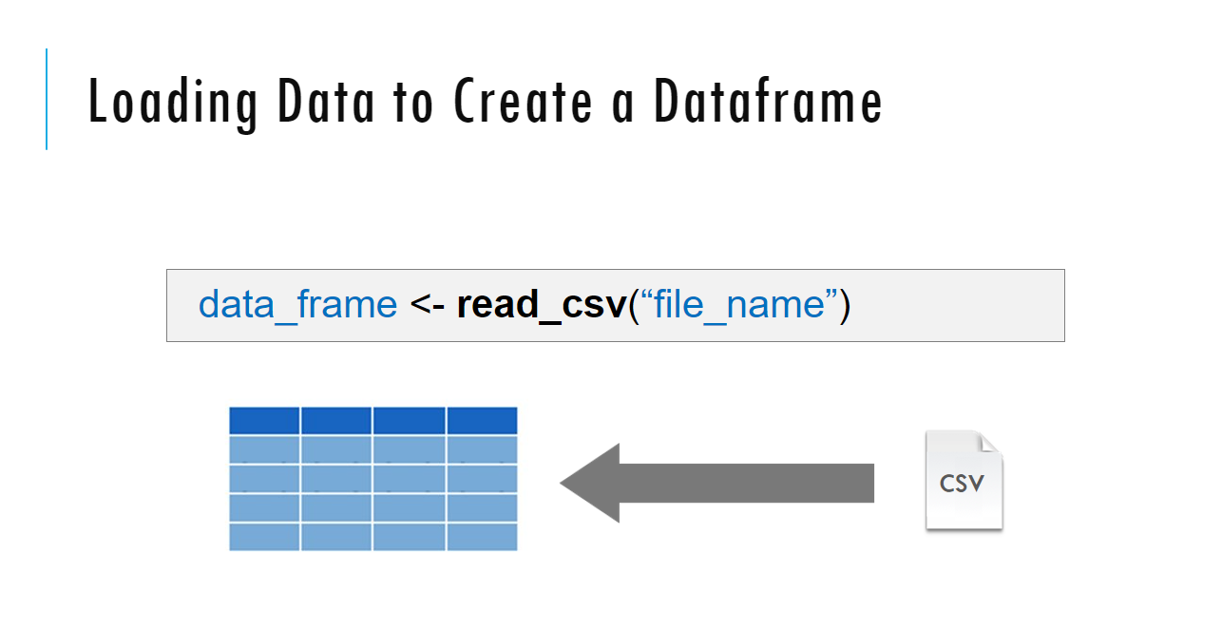
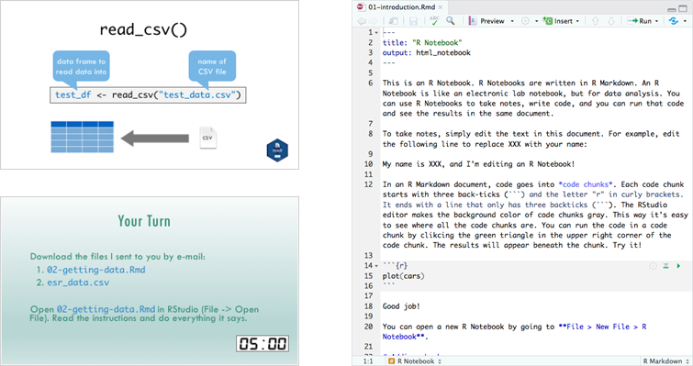
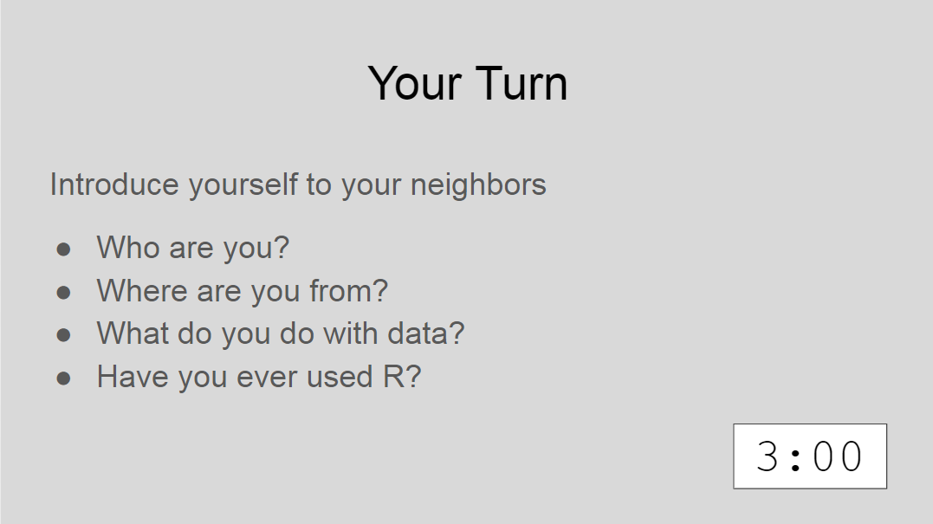
Sessions
Notes:
The meat of the workshop are the sessions each of which will cover discrete subjects or components of R in a data analysis. The sessions have a powerpoint associated with it as well as an R script.
We'll be describing a specific function or topic in the context of the powerpoint – all of which are included in the coursebook and available for download. The same code that is being demoed is included in the R script and you are invited to follow along, run the code, play with it if you like.
At several points in the session we'll have you engage in some exercises which we call Your Turns. In a Your Turn we'll assess how we're doing by asking you to critically think about the topic in the session and respond to a question or do some coding on your own. We'll speak a bit later about how these coding exercises will work.

Slide 6

Using Zoom
One instructor teaching
One instructor assisting
Participants muted
Chat window
Non-verbal feedback
Breakout sessions
Notes:
Let’s talk a little bit about how we'll be using zoom in this workshop.
During the sessions everyone will be muted other than the instructor. We just want to be make sure we don’t get accidental background noise. But that doesn’t mean that there won’t be opportunities for engagement, we want to make sure that this is an interactive workshop and not a one way street when it comes to interaction.
We will be using the chat window in Zoom we will also be using some nonverbal feedback modalities and we'll be using some breakout sessions during which we'll be doing exercises together in an interactive way, more about all this in a few moments.

Slide 7
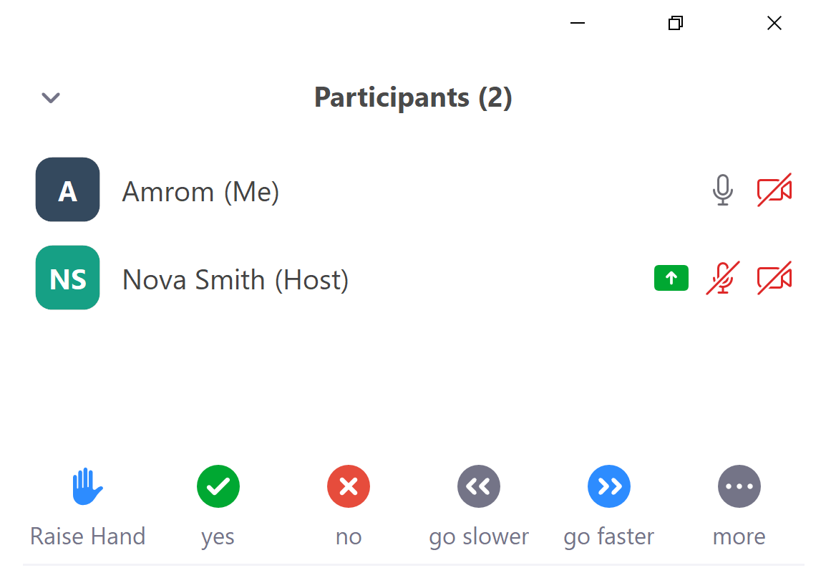
Getting Help
Simple question – Chat window
More complicated - Raise hand, instructor will message
Really complicated – Breakout session
Notes:
During the workshop sooner or later you’re going to need some help.
If you find yourself having a question or needing assistance during a presentation you have a few options.
If its pretty simple or as an initial pass you can drop it in the chat window.
You're also welcome to click the raise your hand icon and an instructor will send you a message and at that point you can try to work through the issue together and if need be you can jump into a breakout room with an instructor to get more intense help
There may be issues that are just too challenging to handle in the context of a virtual workshop. If that does occur we’re going to ask you to make a note of the issue, try to keep with the workshop, and hopefully we can find a way to take it off line.

Slide 8
Tips for learning
Cheatsheets show how to do common things – orient yourself with them early
The best way to learn to code is by doing
Practice is key!
Programming is hard, even for those with a lot of experience. Find resources and ask for help!
Notes:
And just some final words before we begin, no matter what you're learning but particularly coding, the best way to learn is by doing:
Find a project, make a goal for yourself, push yourself to use R, it's OK to lean on some excel, we all do when we're starting out, but try to get that activation energy to get your hands typing code. We would not be teaching this course if we didn't strongly believe that R is accessible to all of you. So keep practicing and you'll get there.
With that let's get started with the workshop. Up next Joe will provide us with the basics of R and get us up and running with Rstudio Cloud.

Slide 9
course preparation
Please download the data from the links provided in the email sent by Shannon earlier this week!
Set your working directory to the folder with the course contents
Place the data folder within your working directory

Slide 10
Pre-course survey results
Course survey

Slide 11
R Markdown crash course

Slide 12

Notes:
R Markdown provides us with features and tools to tackle the reproducibility problem.
In R Markdown, we can craft computer code mixed in with narrative annotation that documents the purpose of the code and details about the decisions we made in our analysis.
R Markdown provides a lab notebook interface for analysis, visualization, and annotation of our work.
It is quickly becoming the gold standard for reproducible data analysis. In the course we will teach you to use R Markdown and we encourage you to continue using it consistently in your future work. In fact, it is the strongest recommendation we will make to you today.

Slide 13
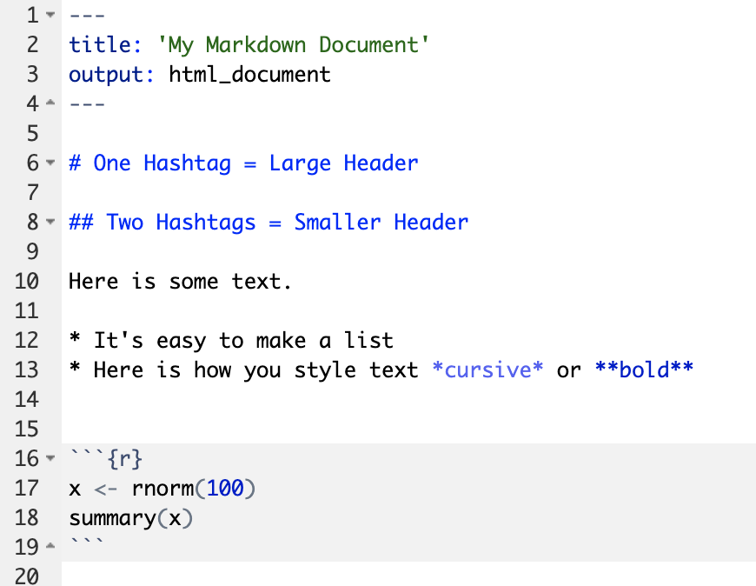
Anatomy of an R Markdown Document
Header
Header
Text (with marks)
Code chunk
Notes:
R Markdown documents are composed of 3 basic building blocks.
**The first is the Header which includes pieces like the name of the document, the document’s author, and the desired output format when the document is assembled.
**The second block is the text. R Markdown documents can be marked in ways that promote readability with various formatting styles.
**Finally, there are code chunks. Code chunks include include R code that can be executed to output results.

Slide 14
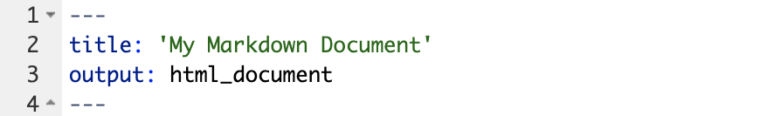
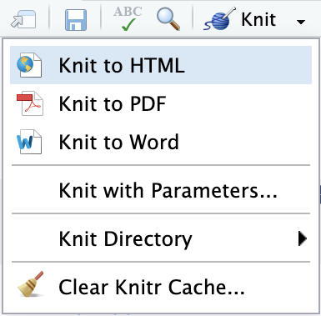
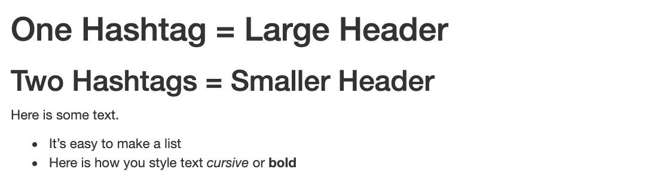
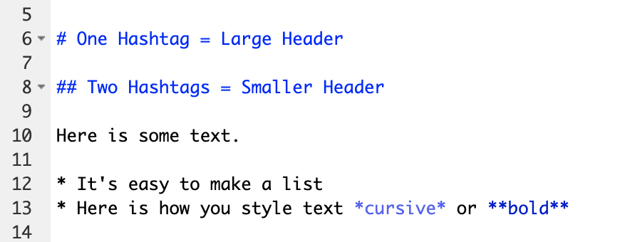
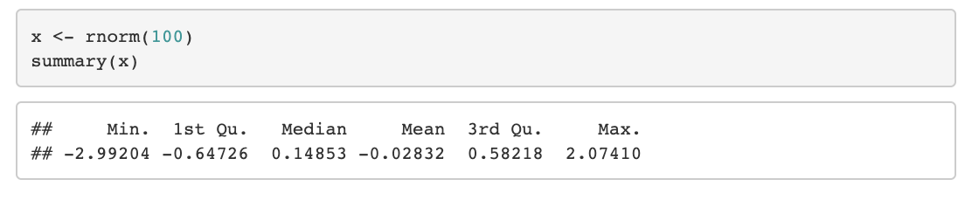
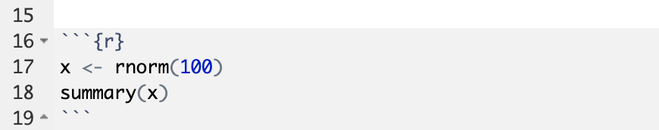
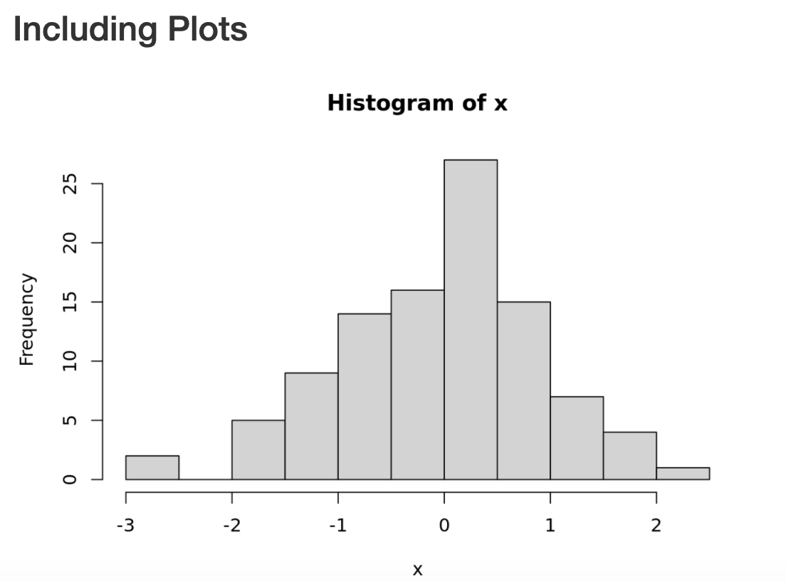
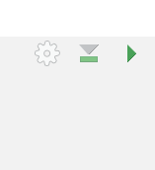
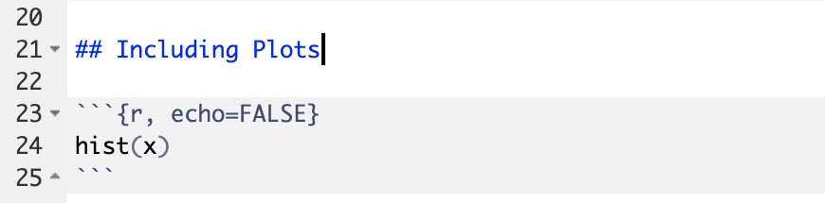
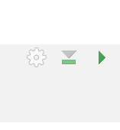
Notes:
Within the R Markdown document, we can execute a single code chunk by ** clicking the “Run Code Chunk” arrow.
And with the click of a button ** (called knitting), we can turn a R Markdown document from this ** to this.

Slide 15
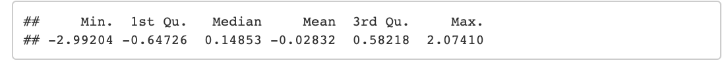
Notes:
Let’s look at this R Markdown document in greater detail.
Again the first block is header section
** The second block includes narrative text with styling applied.
** Then we get to the code chunks (shown in gray boxes). Don’t worry about the grammar of these particular code chunks at this point. In brief the first code chunk generates 100 normally distributed values which are performing a summary on. The knitted document shows us our code ** and the output of that code.
** The second code chunk renders a histogram visualization of that data.
The result is a neatly formatted document that includes an annotated description of our analysis, the code we used, and the output of that code.

Slide 16
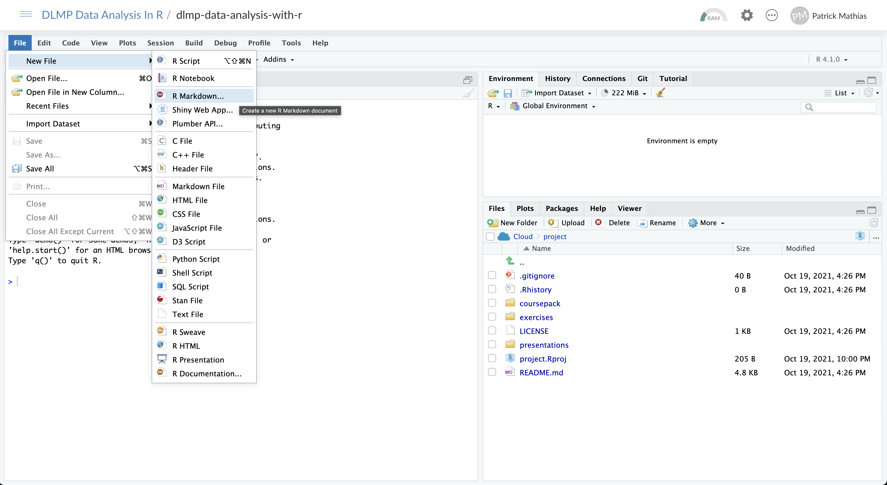

Slide 17
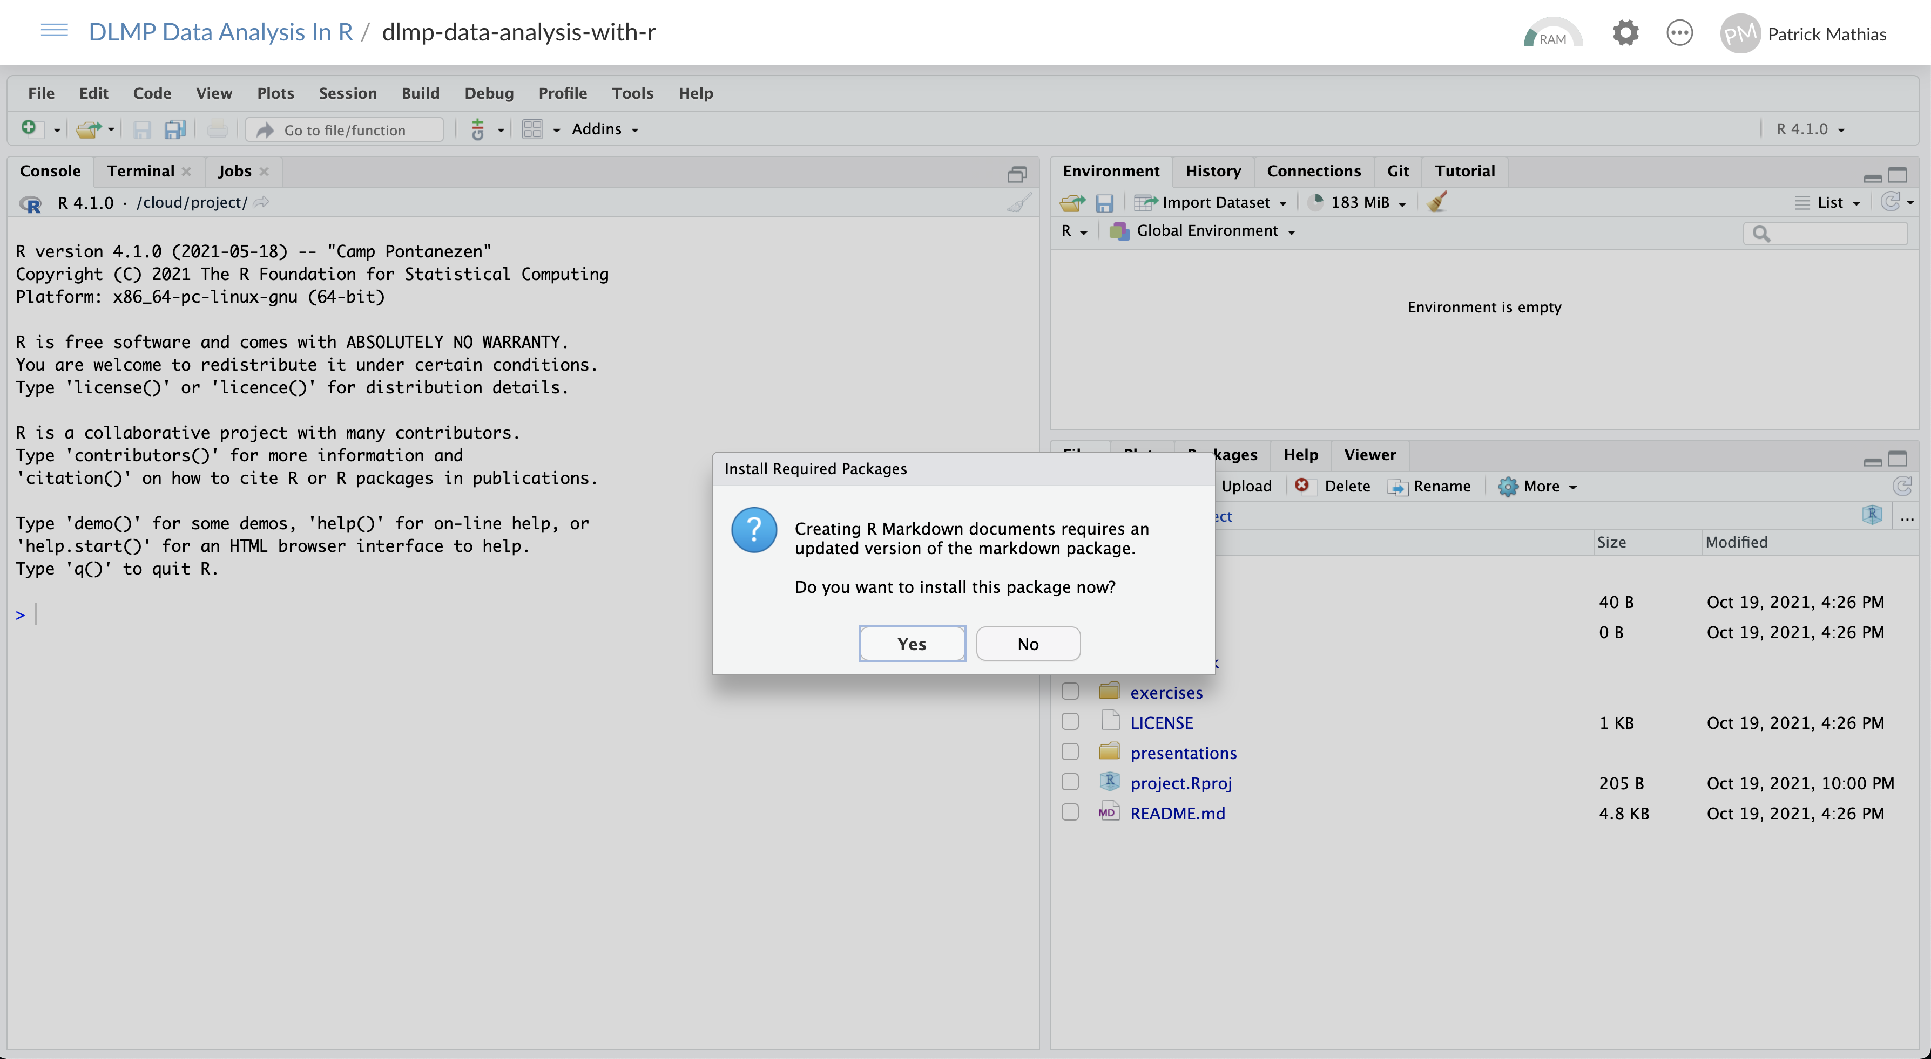

Slide 18
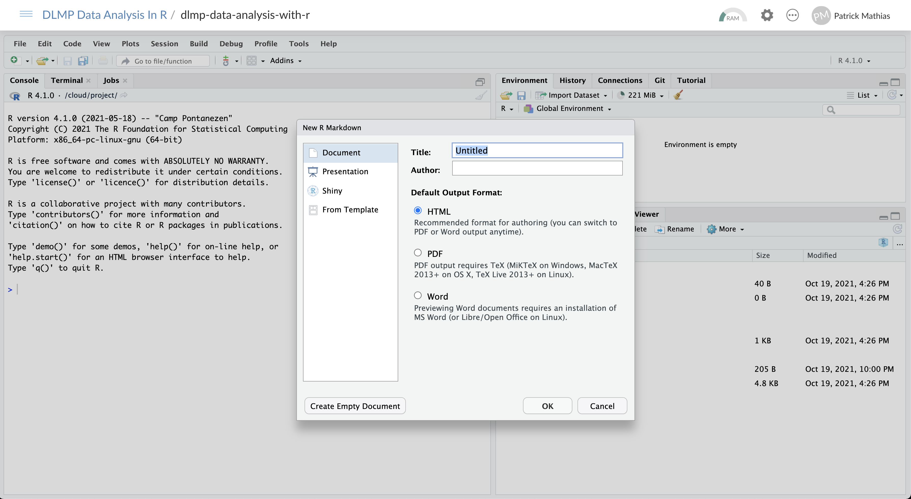

Slide 19
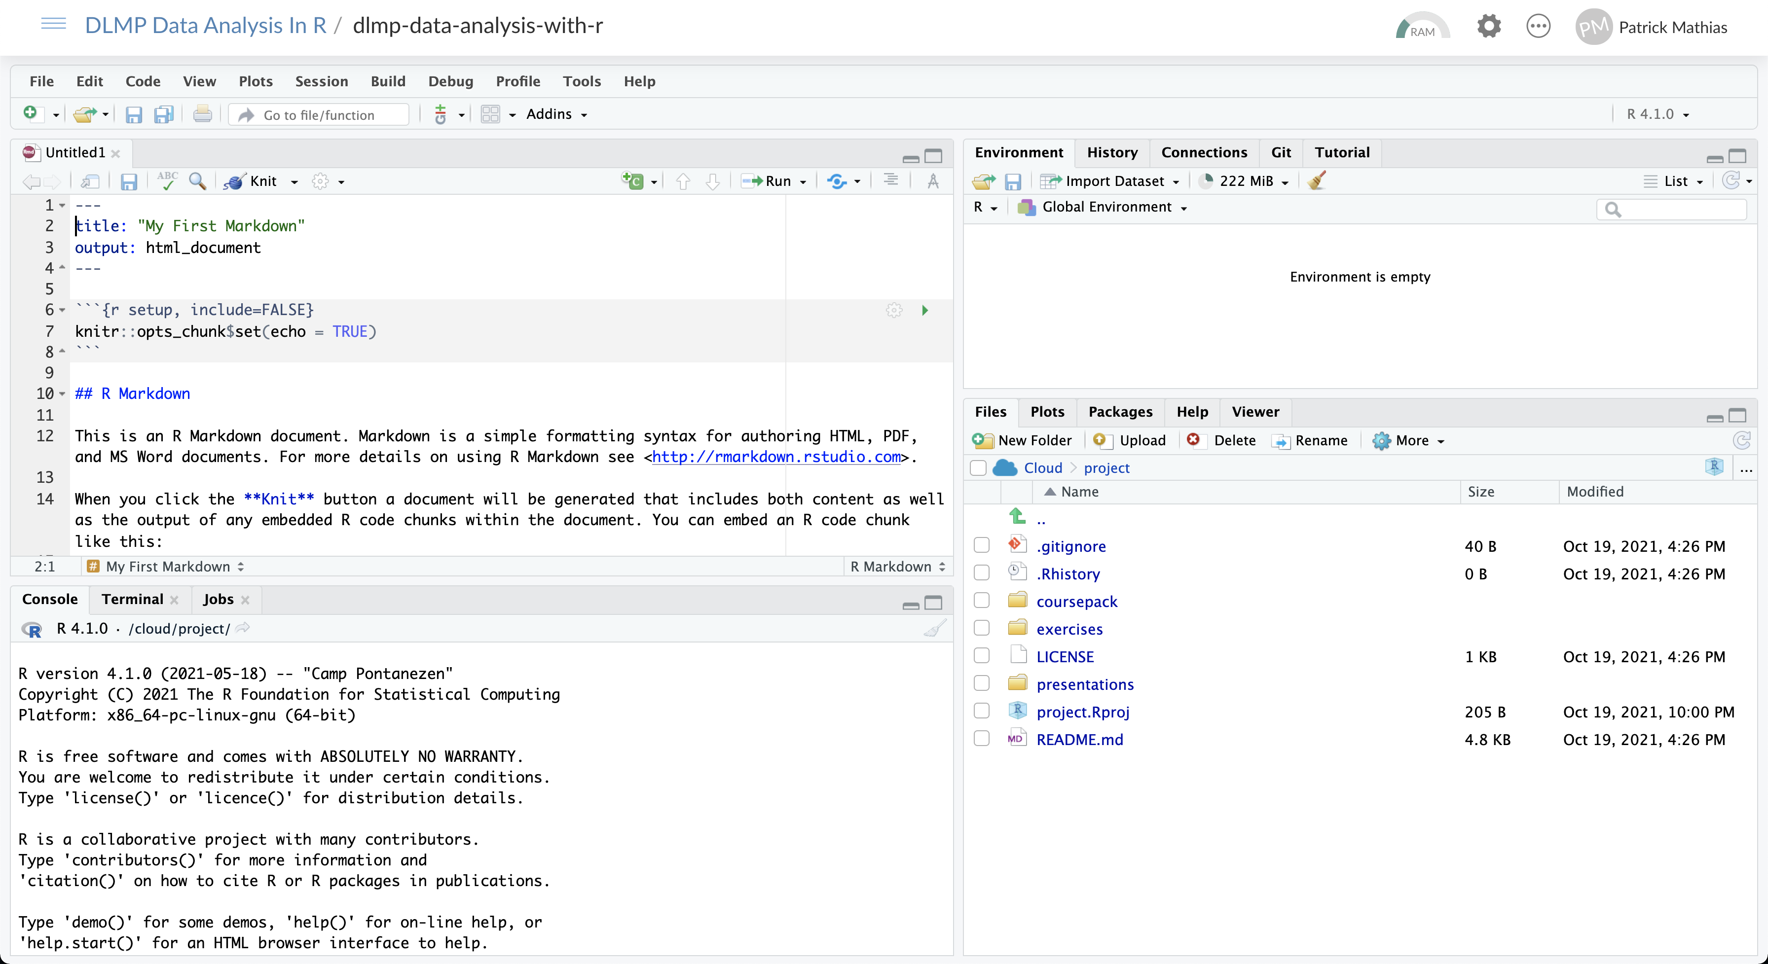
Knit button
Execute code chunk
Scroll down

Slide 20
Code chunks
Language
Chunk name
Open/close with 3 backticks
Run chunk
Code in body of chunk
Notes:
So where does the code go?
We place these in “chunks” that are executable independently and have a very unique syntax
Backticks (top left of your keyboard) open and close code chunks

Slide 21
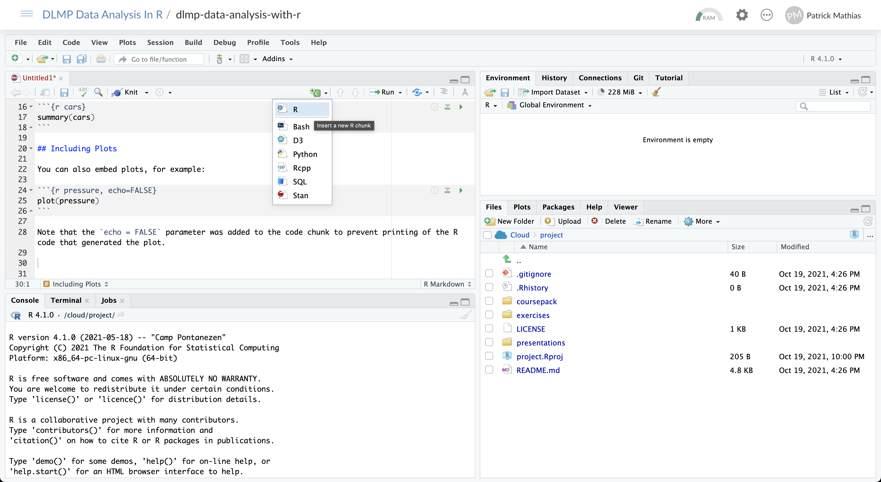
Insert code chunk
Place cursor in document

Slide 22
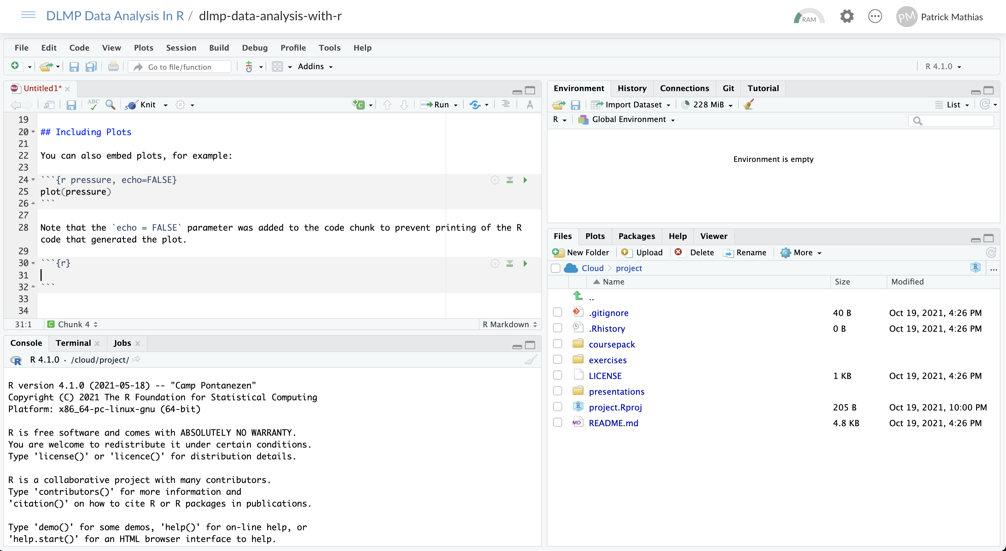
New code chunk

Slide 23
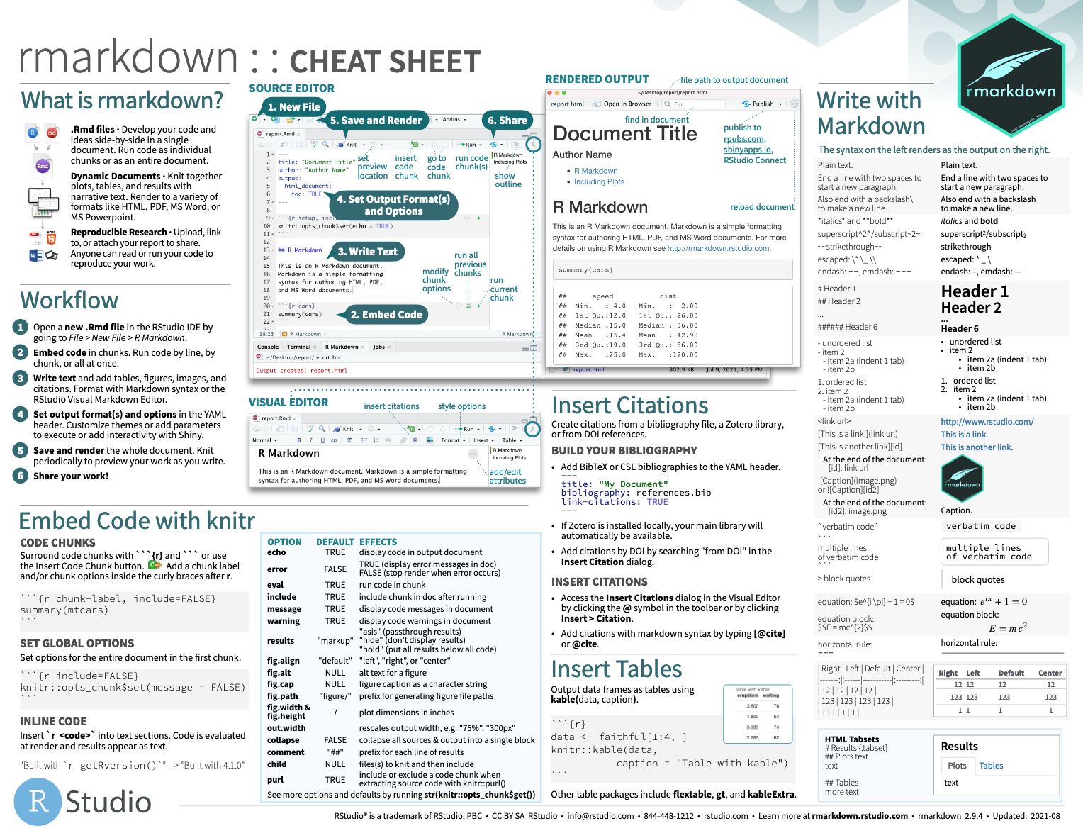
Notes:
The R Markdown cheat sheet helps with the grammar of crafting markdown documents including visual formatting options.
The R Markdown cheat sheet is available on the RStudio website.

Slide 24





Notes:
In this lesson we practiced “knitting” our analysis to an HTML file.
In addition to HTML files, R Markdown documents can be “knitted” into a number of additional formats including PDF, Microsoft Word, PowerPoint, and even interactive dashboards. We will look at dashboards in greater detail later in the course.

